Slide 1

PROJECT ON
Analyzing Hiring Trends and Employee Satisfaction Using AmbitionBox
Presented By : Venkata Naga Sai Prabhath Devalla
Batch No : 435

Slide 2




Agenda
Introduction
Business Problem
Problem Statement
Objective
Web Scraping & Data Collection
Data Collecting Process
Exploratory Data Analysis
Data Visualization
Hypothesis Testing
Conclusion

Slide 3
Introduction
Choosing the right company or industry is a major challenge for job seekers in India due to scattered and unstructured employment data.
Key factors such as hiring trends, job security, work-life balance, employee satisfaction, and career growth are available across platforms like AmbitionBox but are not evaluated collectively.
The lack of weighted comparison makes it difficult to objectively rank companies and industries.
This project addresses the challenge by applying a weighted data analysis approach to evaluate and rank companies and industries, enabling data-driven career decisions for job seekers and stakeholders.

Slide 4
Business Problem
Job seekers in India struggle to objectively compare companies and industries due to fragmented and unweighted employment data across platforms like AmbitionBox. Key factors such as hiring intensity, job security, work-life balance, employee satisfaction, and career growth are available but lack relative importance in evaluation. This leads to slower decisions, poor job-fit, and higher attrition risk. A weighted, data-driven ranking framework is required to consolidate these metrics and enable faster, more accurate career and workforce decisions.

Slide 5
Problem Statement
Job seekers in India find it difficult to identify the best companies and industries because real-time information on hiring, job security, work-life balance, and career growth is scattered across platforms like AmbitionBox. Since these factors are not evaluated based on their importance, comparing companies becomes challenging. This project solves the problem by using a weighted data analysis approach to rank companies and industries, helping job seekers and stakeholders make better, data-driven decisions.

Slide 6
Objective
The objective of this project is to analyze and rank companies and industries in India using a weighted data-driven approach by integrating key employment factors such as hiring trends, job security, work-life balance, employee ratings, and career growth.
This project aims to simplify company comparison, reduce information fragmentation from platforms like AmbitionBox, and support job seekers, recruiters, and stakeholders in making informed and reliable career decisions.

Slide 7
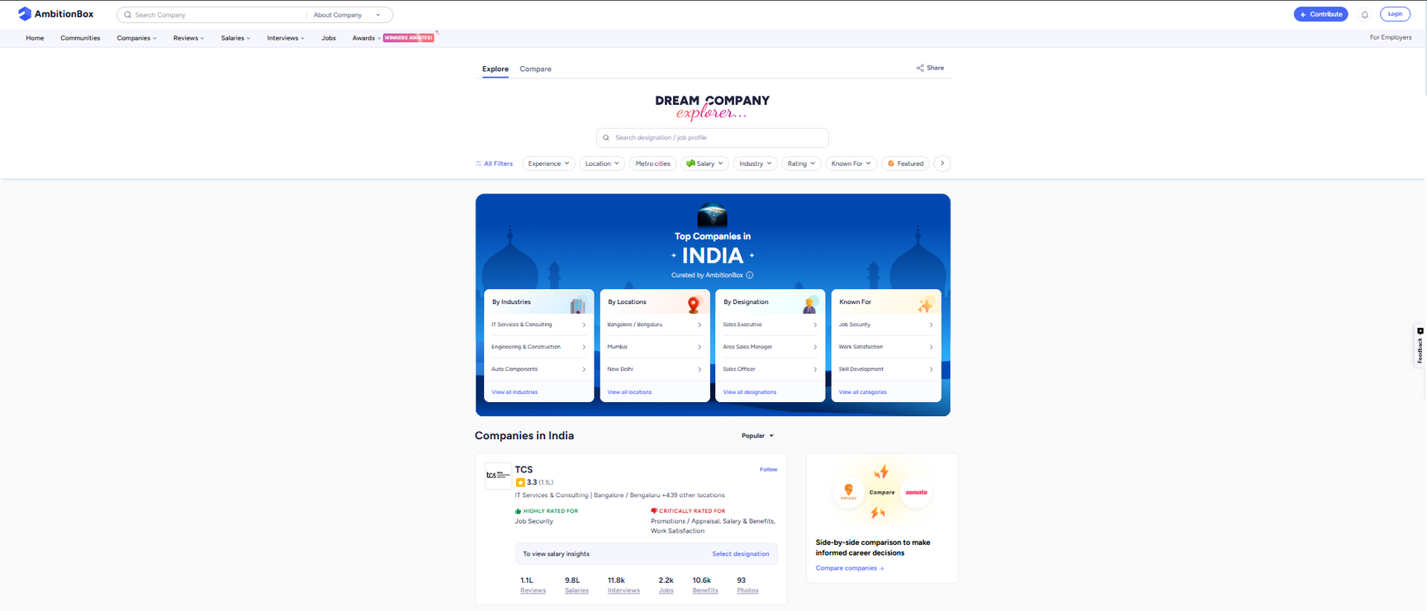
Web Scraping & Data Collection
URL: https://www.ambitionbox.com/list-of-companies?campaign=desktop_nav

Slide 8
Data Collecting Process
Target website identified (AmbitionBox).
Company listing pages accessed using Selenium.
Webpage content fetched dynamically.
HTML parsed using BeautifulSoup.
Required company details extracted.
Extracted data stored in Python lists.
Data converted into a Pandas DataFrame.
Final dataset exported to CSV file.

Slide 9
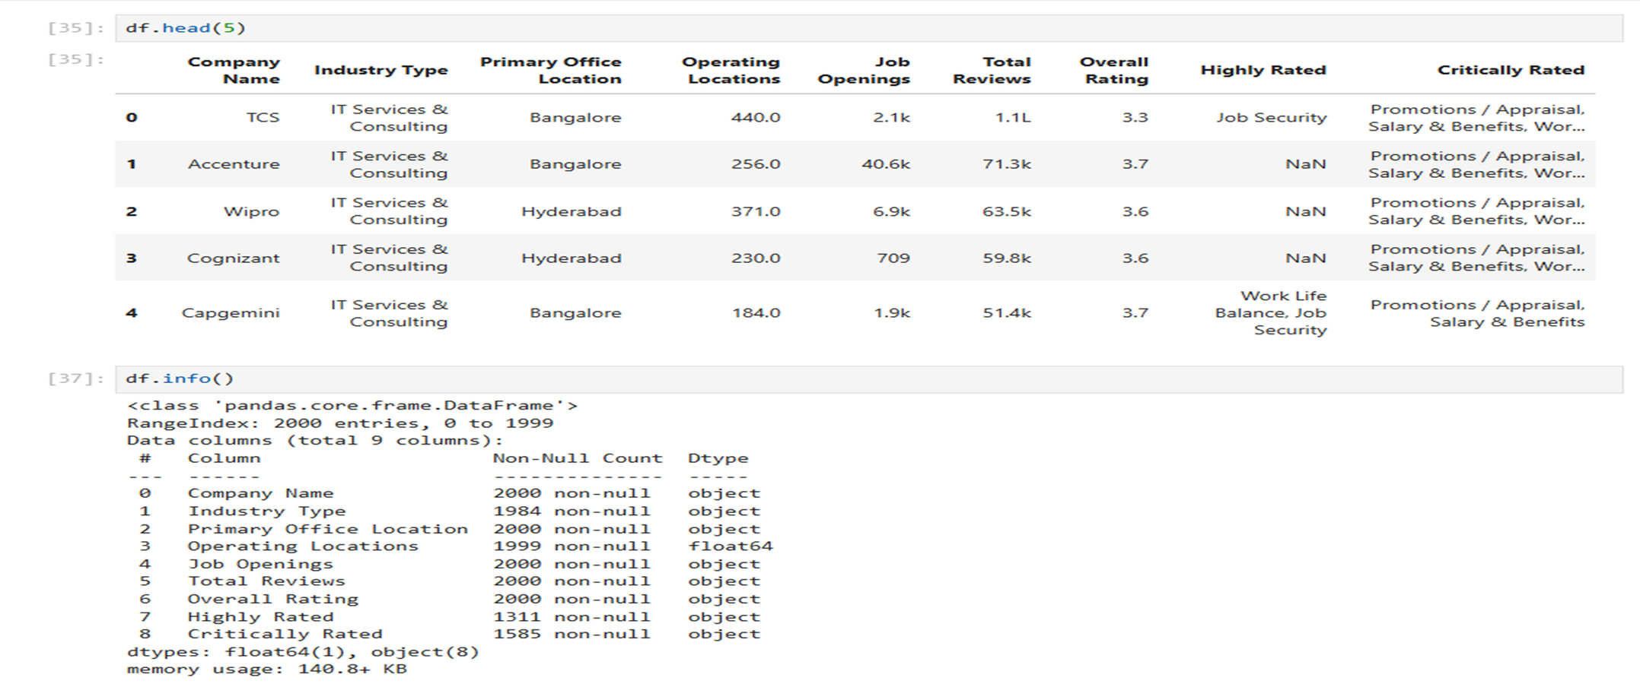
Raw Data

Slide 10
Exploratory Data Analysis (EDA)
Created Feature Columns :
Extracted Job Security, Work Life Balance, etc., from text ratings.
Dropped Redundant Columns :
Removed unnecessary columns such as Highly Rated and Critically Rated.
Handled Missing & Invalid Values :
Replaced missing entries like nan, NaN, None, –, and empty values with zero.
Cleaned Numeric Columns :
Standardized Job Openings and Total Reviews by converting k (thousands) and
l (lakhs) into numeric values.

Slide 11
Exploratory Data Analysis (EDA)
Converted Data Types :
Transformed cleaned numeric columns into integer format for accurate analysis.
Fixed Industry Type Column :
Trimmed extra spaces and replaced missing industry values with Other.
Converted Ratings to Float :
Converted Overall Rating into float format to support numerical analysis.
Optimized Categorical Columns :
Converted columns such as Industry Type, Primary Office Location, Job Security,
Work Life Balance, Work Satisfaction, and Promotions into categorical data types.

Slide 12
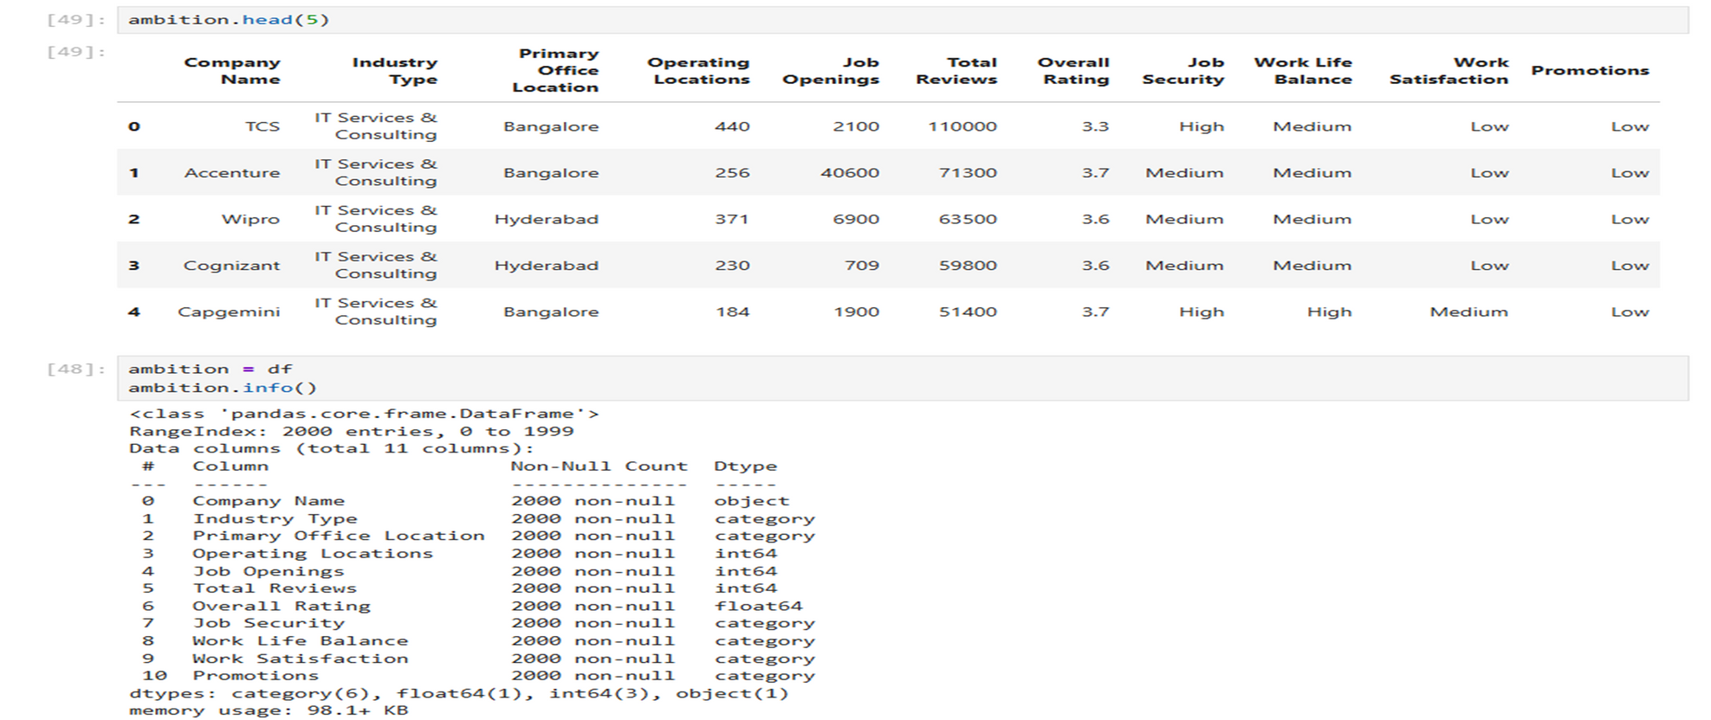
Cleaned Data

Slide 13
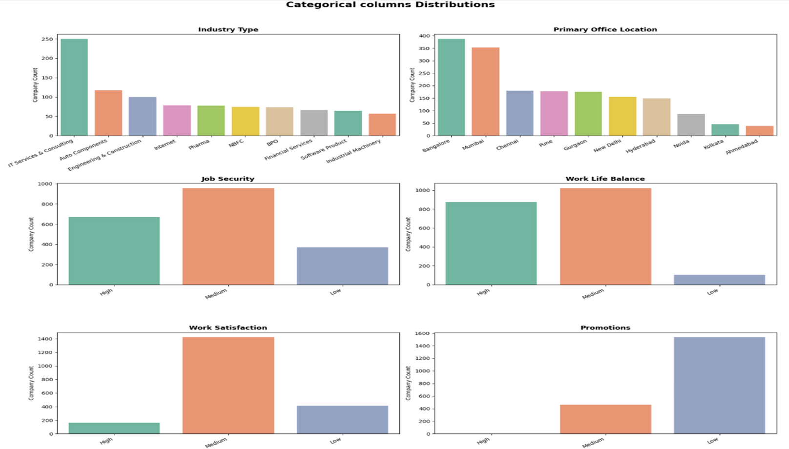
Univariate Analysis (Categorical)

Slide 14
Categorical Insights
IT Services & Consulting is the leading industry, followed by Pharma, Banking, Insurance, and other finance-related sectors, indicating strong dominance of service-based industries.
Bangalore and Mumbai emerge as the most common primary office locations, reinforcing their position as India’s major corporate and employment hubs.
Job security is largely positive, with the majority of companies falling under high or medium categories, reflecting overall employment stability.
Work-life balance is mostly rated as medium, suggesting that while conditions are manageable, there is significant scope for improvement in flexibility and employee well-being.
Work satisfaction is predominantly medium, indicating that most employees are coping with their roles but fewer experience high levels of engagement or fulfillment.
Promotions are largely rated low, showing limited growth opportunities in most companies, with high promotion prospects being rare.

Slide 15
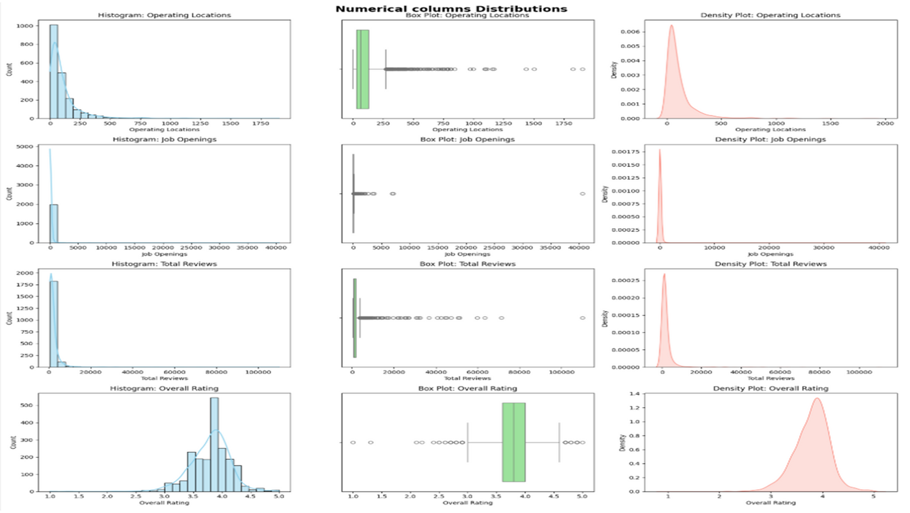
Univariate Analysis (Numerical)

Slide 16
Numerical Insights
Operating locations are right-skewed, with most companies operating in fewer than 200 locations.
Only a small number of companies have a large geographic presence exceeding 1,500 locations.
Job openings are heavily right-skewed, where most companies have fewer than 100 openings.
A few companies dominate hiring, with openings reaching over 40,000.
Total reviews are concentrated among a small set of companies.
Most organizations receive relatively low review counts compared to a few highly visible firms.
Overall employee ratings are stable and normally distributed.
Ratings mostly fall between 3.0 and 4.5, indicating moderate to high satisfaction.

Slide 17
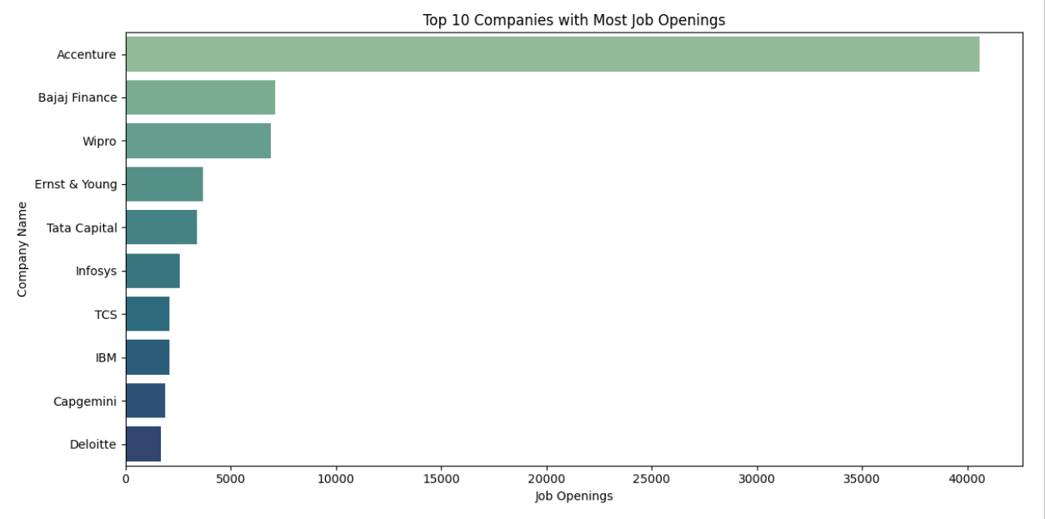
Top 10 Openings With Most Job Openings :
Insights :
Accenture leads large-scale hiring, signaling aggressive growth in IT and consulting, while other major consulting firms also show strong recruitment demand.
Established IT and finance companies such as Wipro, Infosys, TCS, IBM, Capgemini, and Bajaj Finance continue steady hiring, reflecting sustained demand for skilled professionals.
Hiring spans multiple industries, including IT services, finance, consulting, and enterprise solutions, highlighting a diversified and resilient job market.

Slide 18
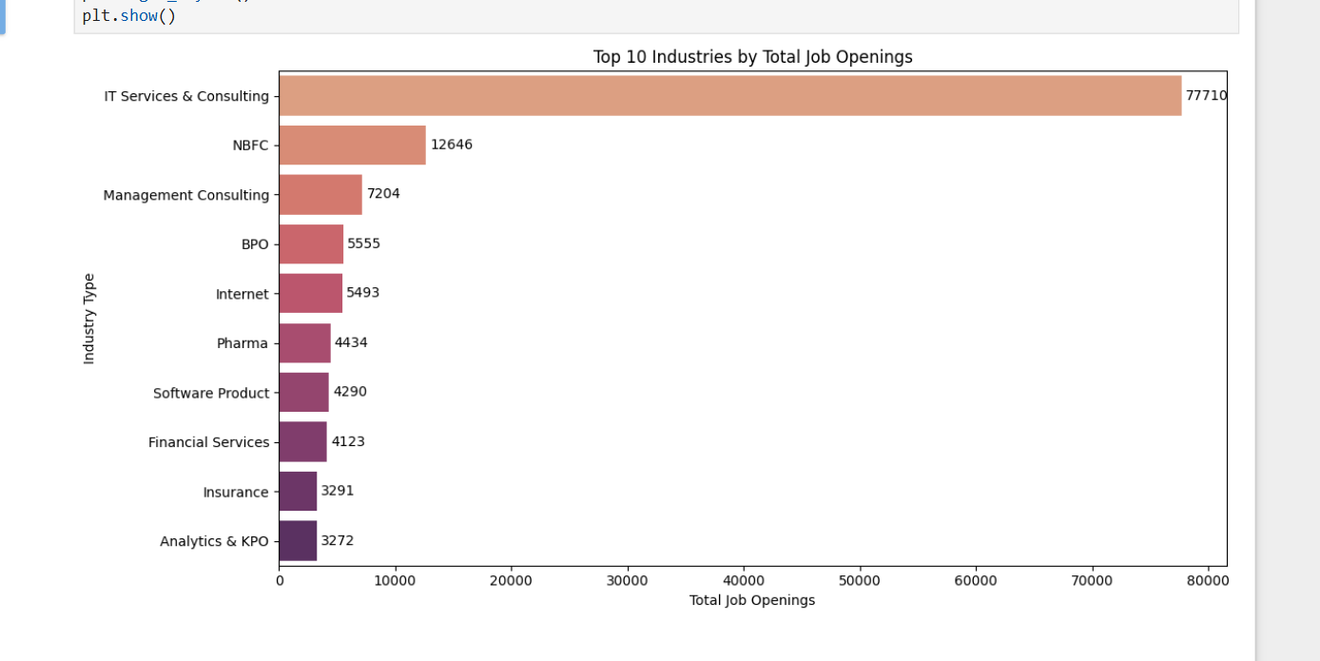
Top 10 Industries By Total Job Openings :
Insights :
IT Services & Consulting dominate India’s job market, accounting for the largest share of job openings and driving overall hiring growth.
Financial and digital sectors remain strong, with NBFCs, Insurance, Internet, and Banking showing consistent and stable recruitment demand.
Data, consulting, and product-based roles are rising, as Analytics, Management Consulting, and Software Product industries continue to expand.

Slide 19
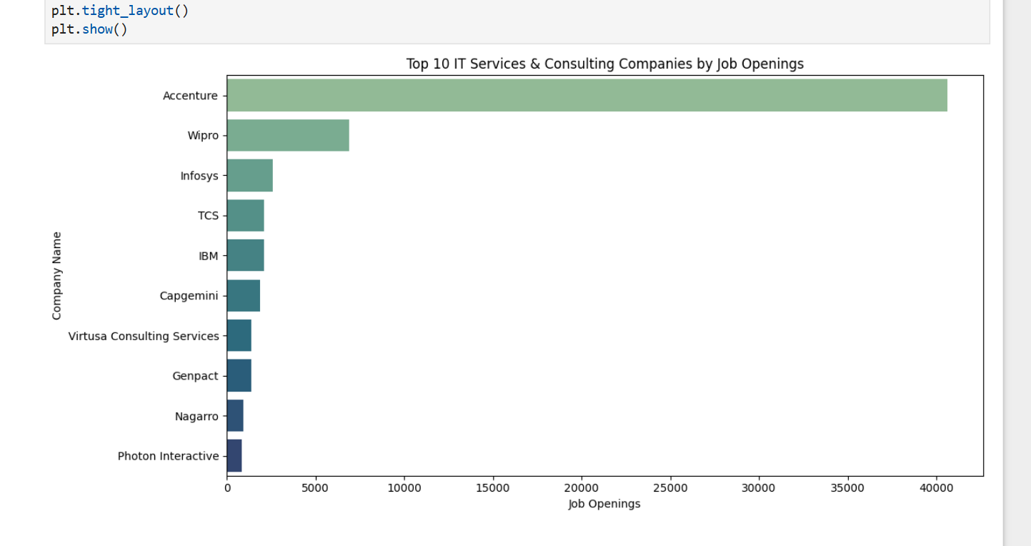
Top 10 IT Services & Consulting Companies by Job Openings :
Insights :
Accenture overwhelmingly leads hiring in IT Services & Consulting, indicating aggressive expansion and large-scale recruitment.
Wipro, Infosys, TCS, and IBM follow with significantly fewer openings, reflecting steady but more controlled hiring among established IT giants.
Mid-sized firms like Virtusa, Genpact, Nagarro, and Photon Interactive maintain a visible hiring presence, highlighting growing opportunities beyond top-tier companies.

Slide 20
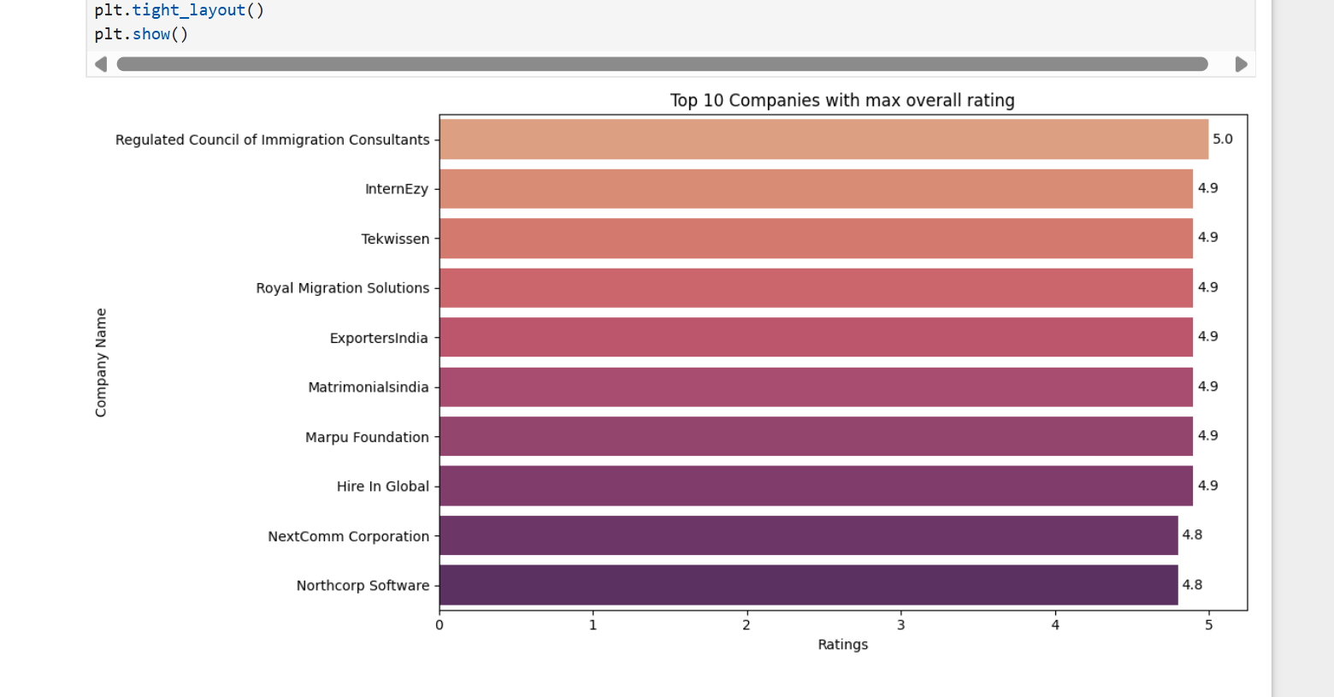
Top 10 Companies With Max Overall Rating :
Insights :
Several companies achieve near-perfect ratings, with the top organization reaching a full 5.0 and others closely following at 4.8–4.9, indicating exceptional employee satisfaction.
Highly rated companies span diverse sectors, including immigration services, IT, non-profits, and global hiring firms, showing that excellent workplaces are not limited to a single industry.
Smaller and mid-sized organizations dominate the top ratings, suggesting strong workplace culture and employee engagement can outweigh company size.

Slide 21
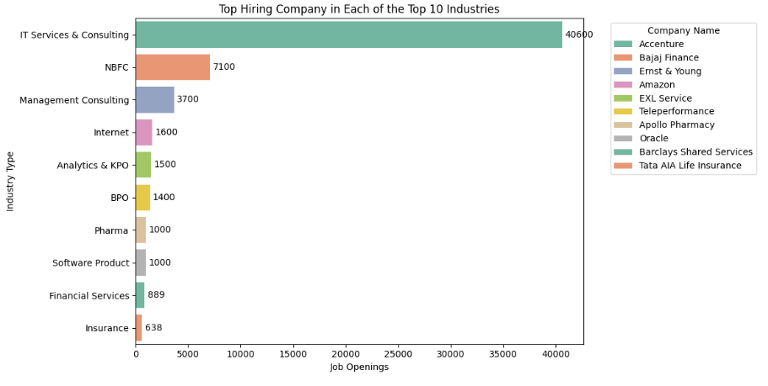
Top Hiring Company in Each Of the Top 10 Industries :
Insights :
Accenture dominates IT Services & Consulting hiring, far outpacing other industries’ leaders, showing strong concentration of demand in core tech services.
Each industry is led by a few dominant employers, such as Bajaj Finance (NBFC), Ernst & Young (Management Consulting), Amazon (Internet), and Apollo Pharmacy (Pharma).
Strong hiring extends beyond pure tech, with Banking, NBFCs, Pharma, BPO, and Analytics sectors also demonstrating steady recruitment demand.

Slide 22
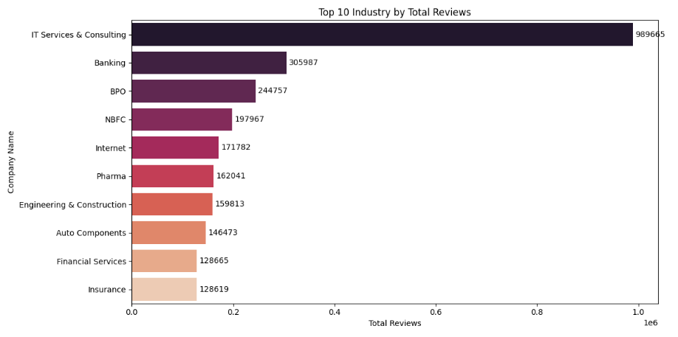
Top 10 Industries by Total Reviews :
Insights :
IT Services & Consulting overwhelmingly lead in total reviews, indicating a large workforce, high employee engagement, and well-established feedback cycles on AmbitionBox.
Banking and BPO sectors follow with substantial review volumes, reflecting their operational scale and structured employee feedback mechanisms.
Sectors like Pharma, Insurance, and Financial Services show lower review counts, likely due to smaller workforce sizes, limited digital engagement, or fewer actively reviewed companies.

Slide 23
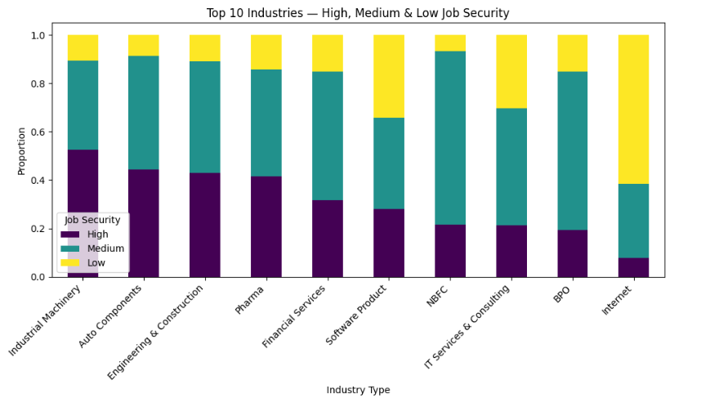
Job Security Distribution Across Top 10 Industries :
Insights :
Automobile and Auto Components industries lead in job security, showing the highest proportion of employees reporting high job stability.
Internet and IT Services & Consulting sectors exhibit lower job security, with a larger share of employees reporting low security, reflecting workforce volatility and project-based employment.
Banking, Pharma, and Financial Services display a balanced security profile, indicating mixed employee experiences with relatively structured and stable roles.

Slide 24
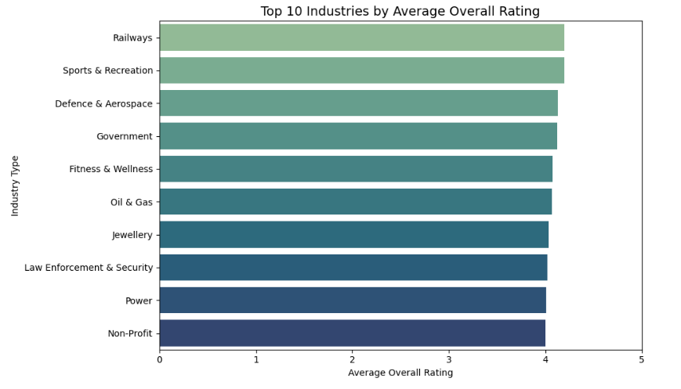
Top 10 Industries by Average Overall Rating :
Insights :
Railways, Sports & Recreation, and Defence & Aerospace lead average ratings, indicating high employee satisfaction in structured, purpose-driven, and stable work environments.
Government, Oil & Gas, and Fitness & Wellness follow closely, reflecting consistent workplace experiences with balanced job security and benefits.
Non-Profit and Power sectors maintain strong ratings, showing that mission-driven and public-utility roles continue to deliver positive employee perceptions.

Slide 25
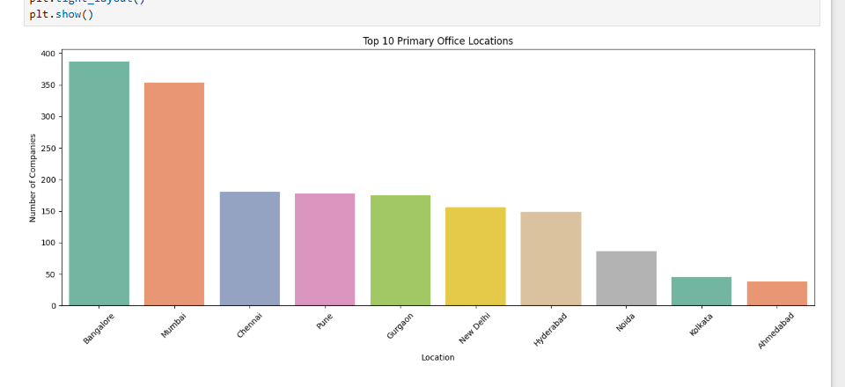
Top 10 Primary Office Locations :
Insights :
Metro cities dominate corporate presence, with Bangalore and Mumbai leading, followed by Chennai, Pune, Hyderabad, and Gurgaon as major business hubs.
Tech and commercial hubs attract the highest number of companies, reinforcing the concentration of employment opportunities in metropolitan regions.
Job seekers gain maximum exposure in these metros, as hiring activity, career growth, and company diversity are strongest in these locations.

Slide 26
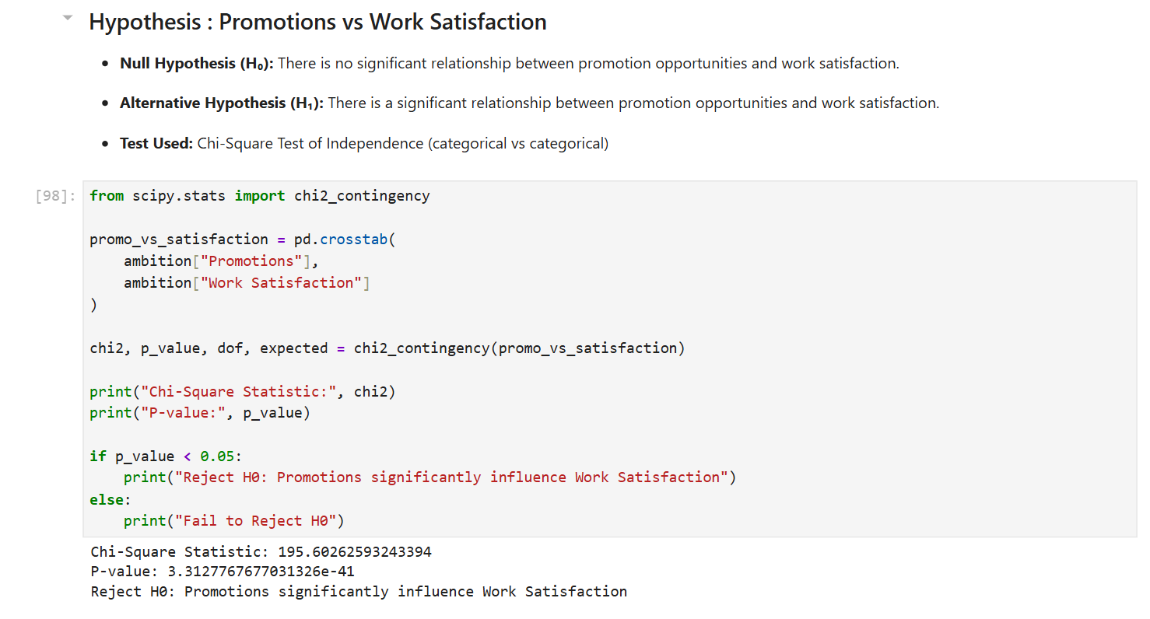
Hypothesis Testing

Slide 27
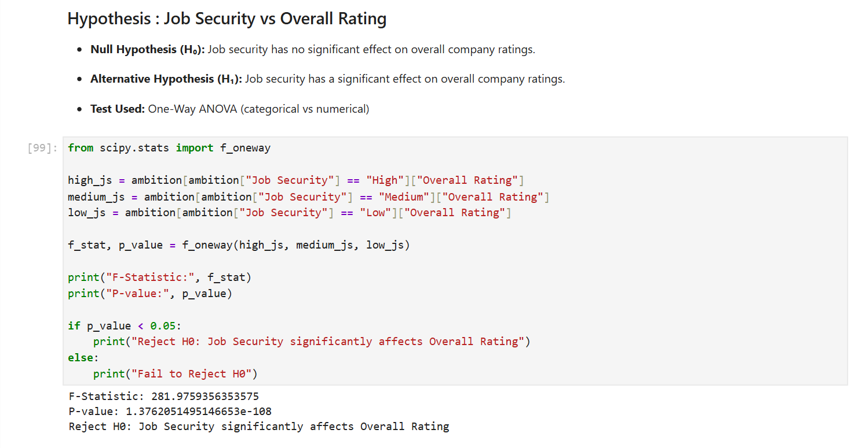
Hypothesis Testing

Slide 28
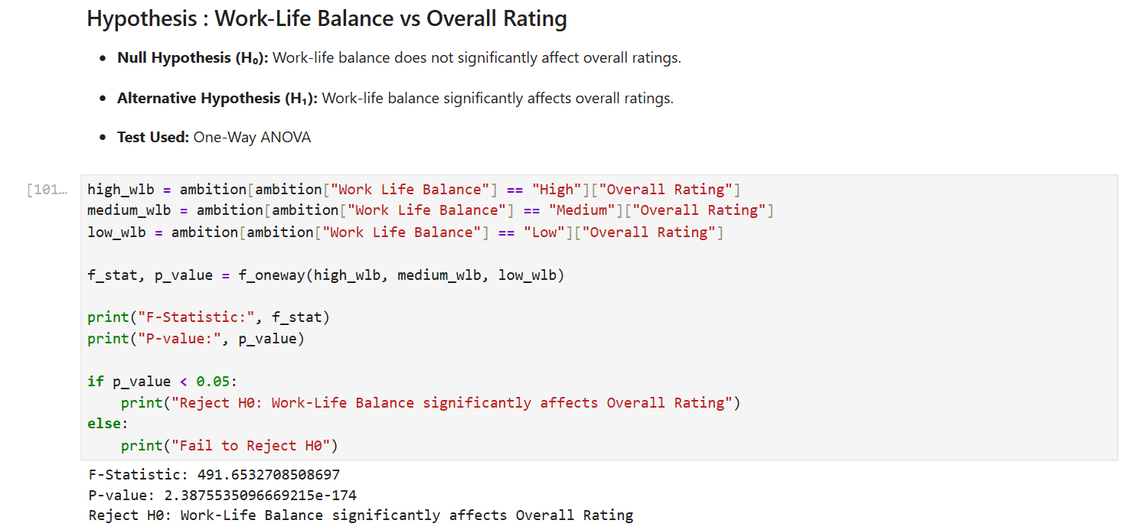
Hypothesis Testing

Slide 29
Conclusion
IT Services & Consulting leads hiring with 35%+ of top companies, followed by Banking, BPO, Pharma, Retail, and Industrial sectors.
Bangalore, Mumbai, Hyderabad, and Pune account for 60%+ of company headquarters, making them India’s main job hubs.
Employee stability is strong, with 85%+ companies rated Medium or High in job security; however, 70%+ report low promotions, showing limited career growth.
Defence & Railways (4.3), Pharma & Healthcare (4.0), Automobile & Industrial (4.0), FMCG & Retail (3.9), and Software Product (3.9) rank as the best industries to work in, proving the value of data-driven rankings.

Slide 30


Slide 31
Thank You

